Slide 1
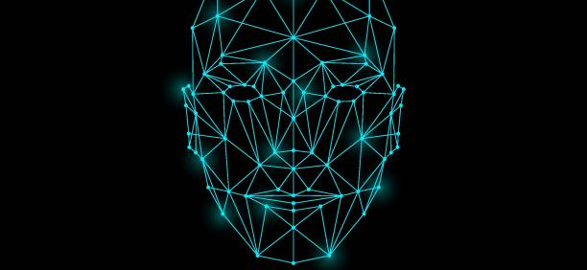
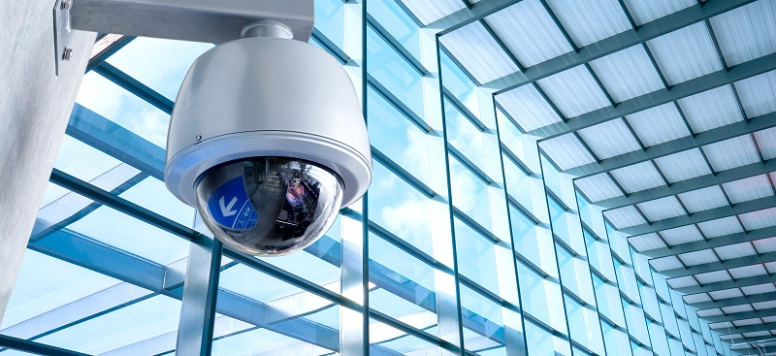
The Ethics of Digital Surveillance: The Case of Clearview AI
Exploring Privacy, Legal Boundaries, and Ethical Implications
Utsav Chaudhary

Slide 2
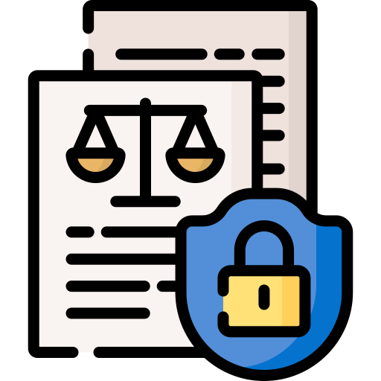
Introduction
Clearview AI uses facial recognition technology extensively
Scrapes images from social media without consent
Creates a massive database for law enforcement
Raises significant privacy and ethical concerns
Faces legal scrutiny and regulatory challenges worldwide
Questions about accuracy and bias in technology
Highlights the need for more transparent data protection laws

Slide 3
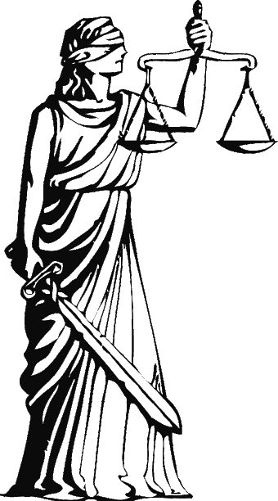
Significance
Large-scale, unauthorized collection of personal data
Challenges traditional privacy expectations and norms
They are widely used by law enforcement agencies globally
Raises concerns about surveillance without oversight
Highlights risks of bias in facial recognition
Prompts debate on ethical and legal standards

Slide 4

Core areas of focus
Privacy
Legal implications
Ethical concerns

Slide 5
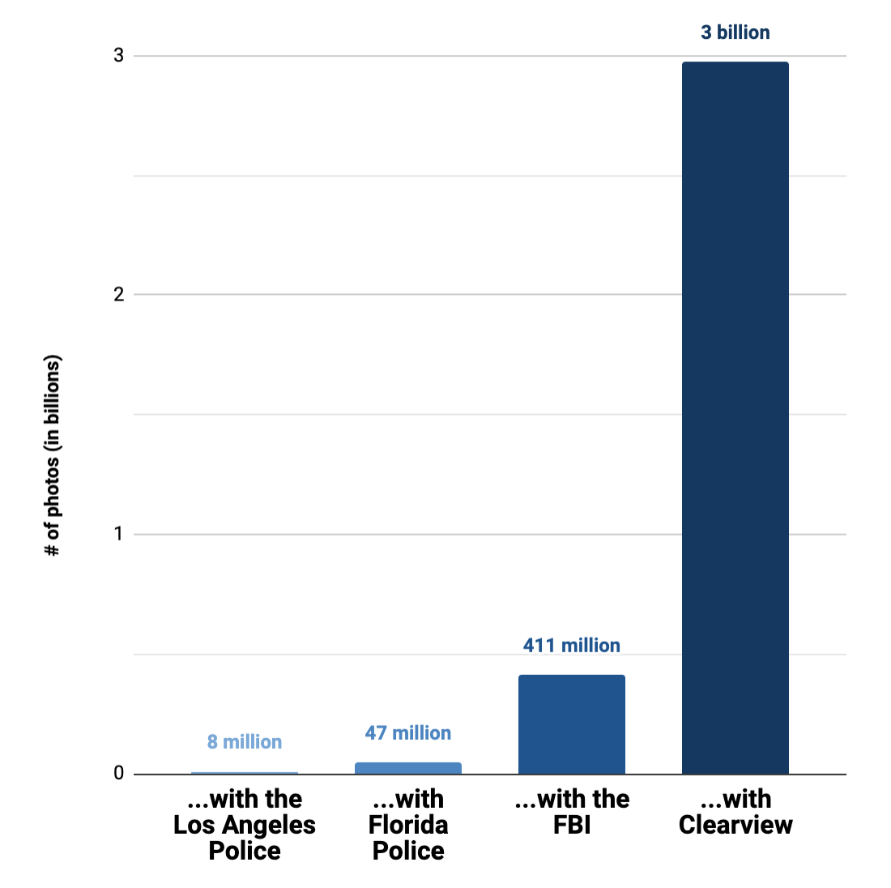
Overview
Founded in 2017
Specialized in facial recognition technology
Scraping images from social media for a database
Used by law enforcement and private companies
Over 3 billion images by 2021

Slide 6
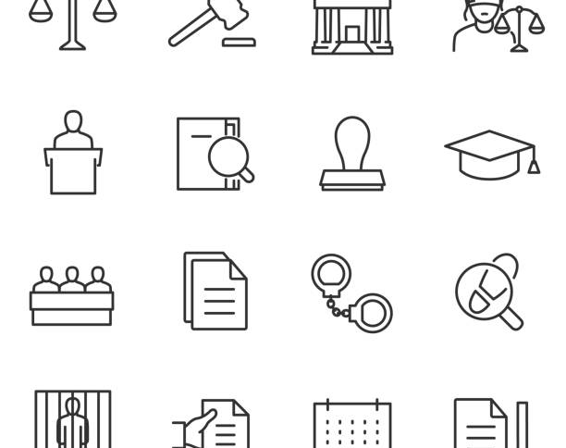
Controversies
Public disclosure of its practices in 2020
Legal actions and regulatory scrutiny in the U.S. and other countries
Ongoing debates and lawsuits

Slide 7
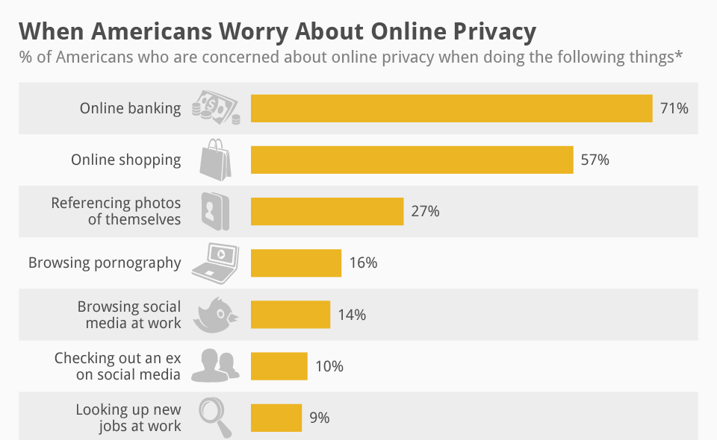
Concerns
Ethical concerns over data scraping without user consent
Public backlash over privacy violations
Most people need to be made aware of their images being collected

Slide 8
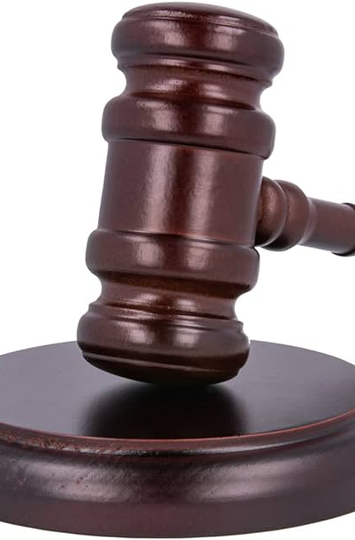
Legal Implications
Biometric Information Privacy Act (BIPA)
BIPA protects biometric data, including facial recognition
Clearview AI faces multiple lawsuits under BIPA
Allegations include collecting data without consent
Violations of user privacy rights in Illinois
Legal actions seek fines and stricter regulations
BIPA allows private individuals to sue companies
Clearview AI's practices challenge existing privacy laws

Slide 9
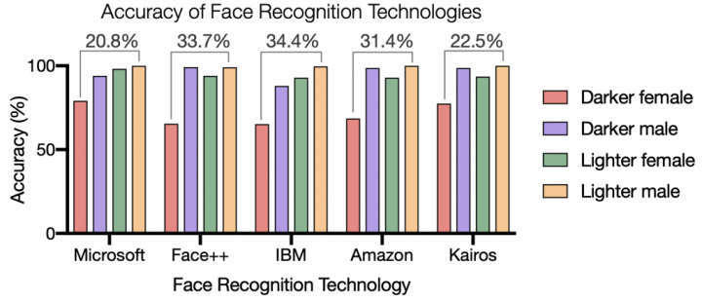
Use by Law Enforcement
Identifies suspects using facial recognition technology
Assists in solving cases of child exploitation
It helps track down human trafficking network members
Supports law enforcement investigations with database access
Matches suspect photos to online image sources
Claims to enhance crime-solving efficiency significantly
Provides real-time identification during active investigations

Slide 10

Analysis
Multiple lawsuits for privacy rights violations were filed
BIPA lawsuits challenge data collection practices
Legal scrutiny from U.S. federal authorities
International bans imposed by various countries
Calls for stricter biometric data regulations
Privacy advocacy groups support ongoing legal actions
Potential fines and restrictions on business operations

Slide 11
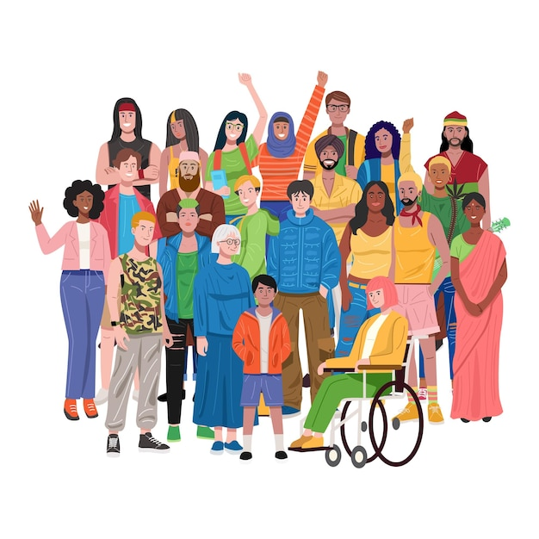
Balancing security and privacy
Ensuring public safety while respecting individual rights
Implementing transparent and accountable surveillance practices
Requiring consent for data collection processes
Limiting data access to authorized personnel only
Establishing clear guidelines for technology usage
Regular audits to prevent misuse and abuse
Promoting ethical standards in law enforcement applications

Slide 12

Conclusion
Privacy concerns
Legal implications
Ethical dilemmas
Responsible use
Ongoing public and academic debate on these issues

Slide 13
Works Cited
Scholarly
Legal
Hill, Kashmir. "The Secretive Company That Might End Privacy as We Know It." The New York Times, January 18, 2020.
Simonite, Tom. "This is how AI bias really happens—and why it's so hard to fix." MIT Technology Review, February 4, 2020.
Whittaker, Meredith, et al. "AI Now Report 2018." AI Now Institute, December 2018.
Crawford, Kate, and Ryan Calo. "There is a blind spot in AI research." Nature News, October 13, 2016.
Fussell, Sidney. "Facial recognition software regularly misgenders and misidentifies trans people. Researchers want to fix that." The Washington Post, November 10, 2019.
Selinger, Evan, and Woodrow Hartzog. "The Inconsentability of Facial Surveillance." Loyola Law Review, Vol. 66, 2019.
Gates, Kelly A. "Our Biometric Future: Facial Recognition Technology and the Culture of Surveillance." New York University Press, 2011.
Chin, Gabriel J. "Race, The War on Drugs, and the Collateral Consequences of Criminal Conviction." Journal of Gender, Race & Justice, 6(2), 2002.
Koepke, Logan, and Harlan Yu. "The Perpetual Line-Up: Unregulated Police Face Recognition in America." Georgetown Law, Center on Privacy & Technology, October 18, 2016.

